Slide 1

Hands-on Experiences on AI Implementation
AI Solution Through Robotic AI Tool
Module 13 Walk Through of the idareAI

Slide 2
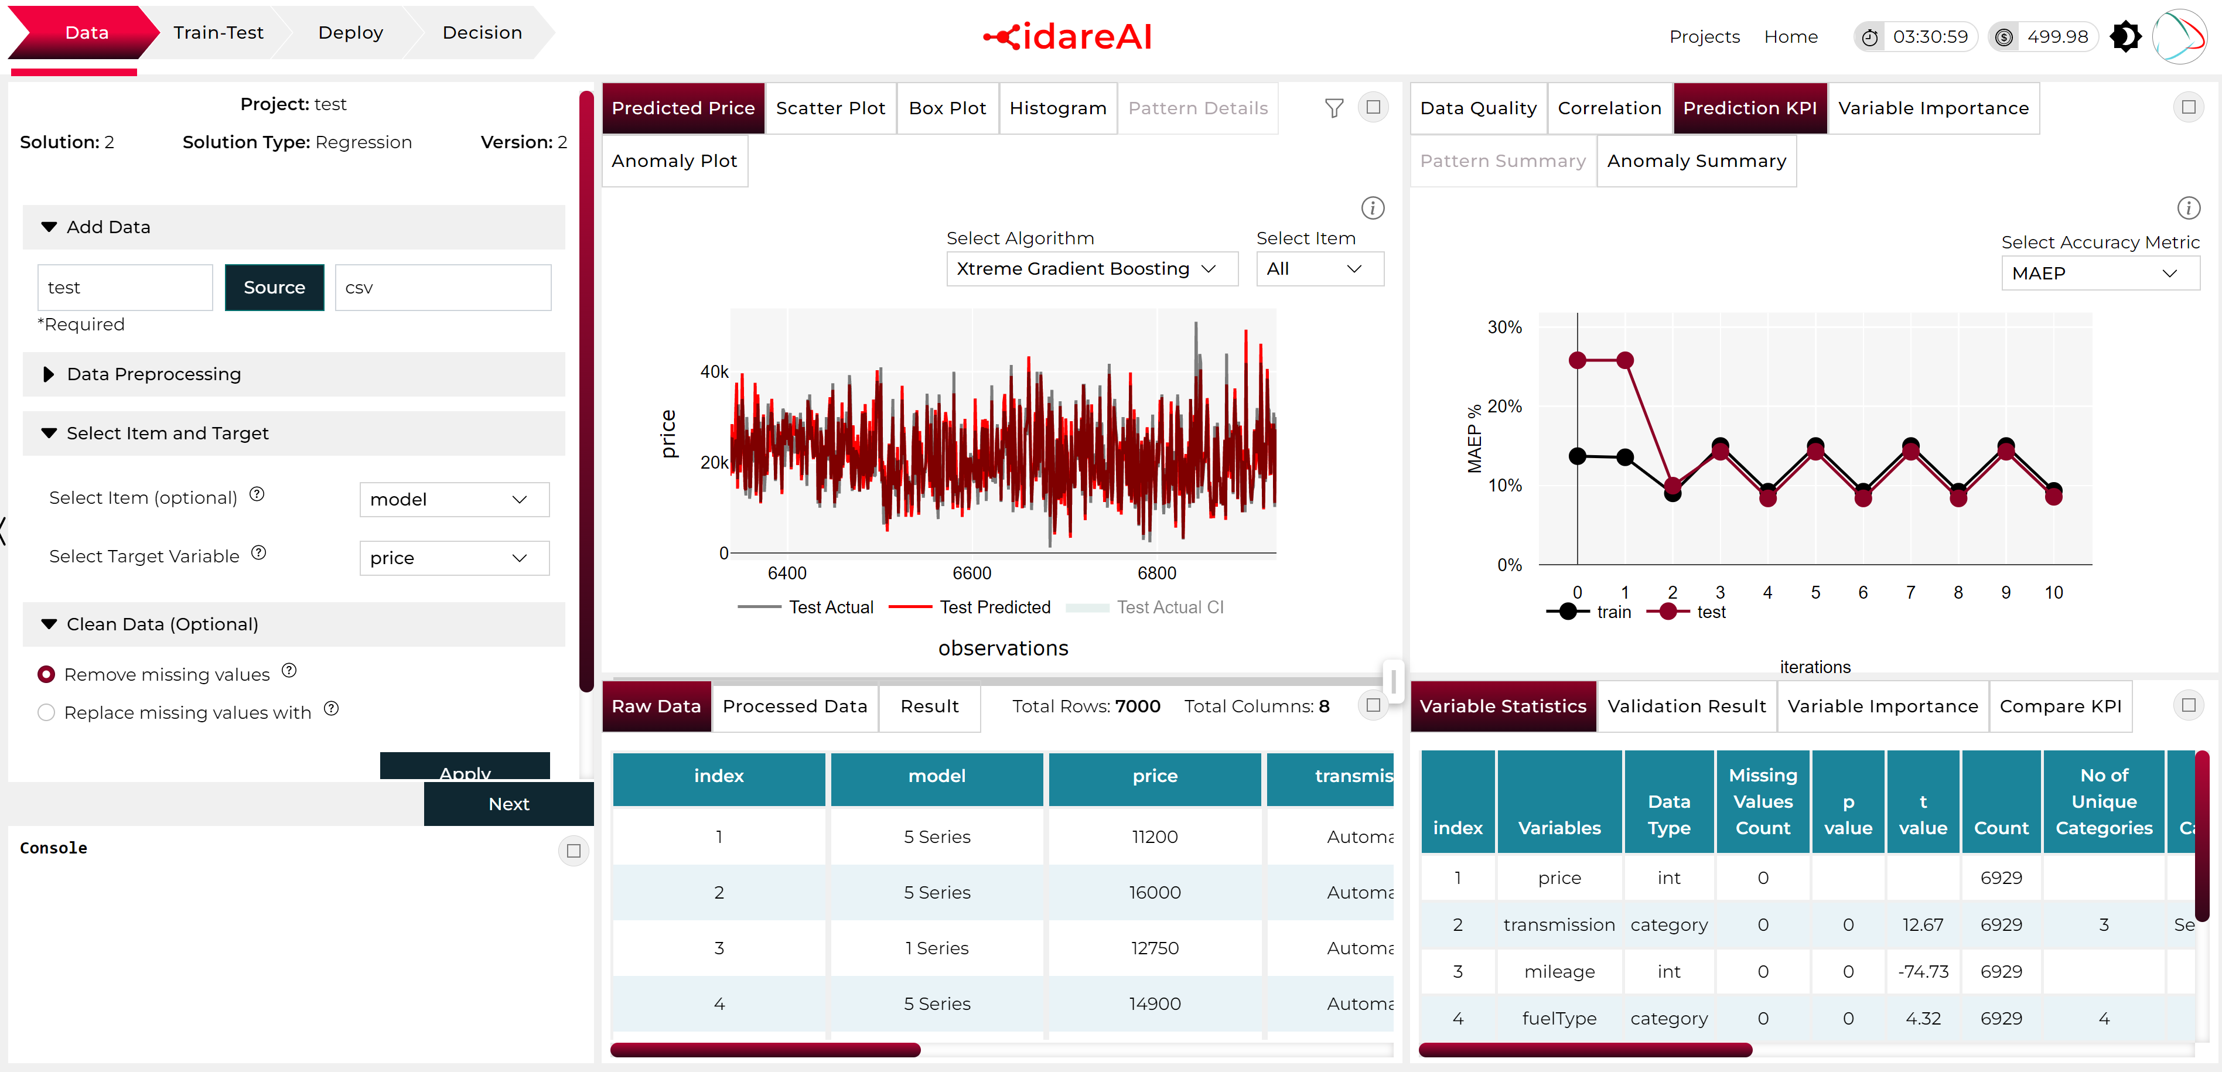
4 Steps of Solution Creation
Project
Space
Home Page
Dark Mode or
Light Mode
Data Collection
& Pre-Process
Build Model
Training-Testing
Deploy for
Production
Get Decision
User Admin
Data Insights
Analysis Insights
Operation Panel
Predicted Target chart
Scatter Plot
Box Plot
Histogram
Detected Patterns
Variable Line chart with Anomaly
Data Quality
Correlation Heatmap
Prediction KPI:Train-test Error
Variable or Feature Importance chart
Pattern Summary
Input Data Connect to a Source
Data Preprocess
Clean
Operation
Pattern Recognition
Select Item and Target
Preliminary Analysis
Data Table
Variable Insights Table
Raw Data
Processed Data (Feature Data)
Prediction Result for testing data
Variable Statistics
Validation Result
Variable Importance
Compare KPI (errors)

Slide 3
Does and Don’ts:
Data Structure Related
Most of the bad data related issue is taken care off automatically, however avoid following or use excel to modify your data set, if Data set contains following
Avoid fully unstructured data
Data set that contains categorical or string column with unique values that may fall into training data set but
Data set that contains date column with mixed date type format. Please use excel to fix date issues.
Data set that contains letters other than English, symbols. Replace with English letter in Excel
Data set that contains exponential form of number i.e. 1E2, convert into numeric decimal to 100
Data set that contains Columns with ALL blank, missing or null values. Remove the column or uncheck this variable during data import
Data set that contains Columns contains mix of strings and number, removes string numbers and keep blank using Excel
Do not Upload data less than 10 rows and 2 columns. You need at least a variable and a target to perform an AIML solution
The Training module of idareAI limits its capability within structured data set. Unstructured data conversion is available in the Enterprise modules
Example of Unstructured Data

Slide 4
Does and Don’ts:
Variable modification and Equation Creation
Please remember this application write codes at the backend, therefore general error that may happen during manual coding or following incorrect sequence may show error running the analysis. Following error may happen if operation process includes
Moving back and forth between build model and data page. If error occurs for such heavy cases,
Please upload the data again
Perform all the data modification and equation creation operation in sequence that can be done in the data page before selecting item and target.
Perform all the equation creation operation in sequence in the build model and deploy page
Avoid selecting a modified variable or a created variable as your target because naturally raw data set for future prediction will not contain the source variable of the target.
For regression analysis do not choose categorical or string column for target.
For selecting Item avoid choosing a numerical column unless the column is an identification column for entities, people, IDs etc
Avoid Categorical variables/columns with all unique values as your feature variable

Slide 5


